Slide 1

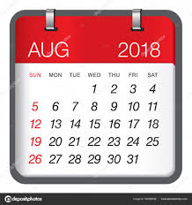
Calendar

Slide 2
Odd days concept :
First 5 years contain 4 normal years and one leap year so 4*1+1*2=6
So 6 odd days
100 years contain 76 normal years and 24 leap years =76*1+24*2 =124/7 = 5 odd days
Similarly,
200 years contain 5 × 2 = 10, i.e., 3 odd days.
300 years contain 5 × 3 = 15 i.e., 1 odd day.
400 years contain 5 × 4 + 1 = 21, i.e., no odd day.
Similarly, 800, 1200 years etc. contain no odd day
1600 Years - 0 odd days
1700 Years - 5 odd days
1800 Years - 3 odd days
1900 Years - 1 odd days
2000 Years - 0 odd days
2100 Years - 5 odd days

Slide 3
Model 1:
Day of Week =(Date + Month code + No.of years + No.of leap years completed + Century code)/7
Month Code:-
Jan | Feb | Mar | Apr | May | Jun | July | Aug | Sep | Oct | Nov | Dec
1 | 4 | 4 | 0 | 2 | 5 | 0 | 3 | 6 | 1 | 4 | 6
Century Codes:-
1500 - 1599 ---> 6
1600 - 1699 ---> 5
1700 - 1799 ---> 3
1800 - 1899 --->1
1900 - 1999 ---> 6
2000 - 2099 ---> 5
2100 - 2199 ---> 3
2200 - 2299 ---> 1

Slide 4
Model 1:
Father of Nation Mahatma Gandhi died on 30th January 1948. What was the day on which he died?
On 2007, What was the date of last Saturday in May month?
A) 21 B) 22 C) 25 D) 26

Slide 5
Model 2:
On what dates of April 2009 did Thursday falls
a)1,8,15,22,29 b)2,9,16,23,30
c)3,10,17,24 d)4,11,18,25
e)5,12,19,26

Slide 6
Model 3:
If the given year divides with 4 then possible remainders are 0,1,2,3.
-28 years -- 0 -- + 28 years
-11 years -- 1 -- + 6 years
-11 years -- 2 -- + 11 years
- 6 years -- 3 -- + 11 years

Slide 7
Model 4:
It was Tuesday on January-1-2006. Find the day of the week on January-1-2010?
A) Sunday B) Saturday C) Friday D) Wednesday
It was Tuesday on March-19-1992. Find the day of the week on Sep-08-2018?

Slide 8
Model 4:
If March 4th is a Tuesday, what day of the week will it be on April 4th?
A) Tuesday B) Saturday C) Friday D) Wednesday
It was Tuesday on March-19-1992. Find the day of the week on Sep-08-2018?

Slide 9
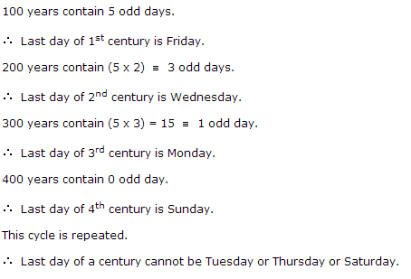

Slide 10

Clock

Slide 11
Angle traced by minute hand in 60 min. = 360°
So in 1 min min hand traced 6°
Angle traced by hour hand in 12 hrs = 360°
So in 1 min hour hand traced 1/2°
Note:
In one min. minute hand gains 5 ½° over the hour hand
In one hour minute hand gains 55 min spaces over the hour hand

Slide 12
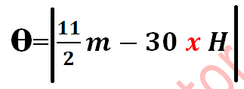
Angle =
Ex: 2 :40
Ex: 2 :40
Min - 40*6 = 240
hour-2*30 + 40/2 = 80
--------------------------------
Angle = 160

Slide 13
What is the angle between the hands of the clock at 7:20
What is the angle between the hands of the clock at 4:35
What is the angle between the hands of the clock at 8:15
What is the angle between the hands of the clock at 10:25
What is the angle between the hands of the clock at 11:45

Slide 14
The time in a clock is 20 minute past 5. What is the angle between the minute and hour hands of the clock??
The time in a clock is 20 minute past to 7. What is the angle between the minute and hour hands of the clock??

Slide 15
An accurate clock shows 8 o'clock in the morning. Through how many degrees will the hour hand rotate when the clock shows 2 o'clock in the afternoon?
A. 144º B. 150º C. 168º D. 180º

Slide 16
Position In Clock | Angle / Min | No Of Times in 1 Hour | No Of Times in 12 Hours | No Of Times in 24 Hours
Co-inside | Angle - 0 Min - 0 | 1 | 11 | 22
Right Angle | Angle - 90 Min - 15 | 2 | 22 | 44
Opposite | Angle - 180 Min - 30 | 1 | 11 | 22
Time
is in minutes
(5H)12/11
(5H∓ 15)12/11
(5H+30)12/11
(5H-30)12/11

Slide 17
At what time between 4 and 5 O'clock will the hands of a clock together
At what time between 4 and 5 o’clock will the hands of a clock Right Angle to each other?
At what time between 4 and 5 o’clock will the hands of a clock Opposite to each other?

Slide 18
At what time between 7 and 8 O’ clock will the hands of a clock Opposite to each other?
At what time between 9 and 10 O’ clock will the hands of a clock Opposite to each other?
At what time between 9 and 10 O’ clock will the hands of a clock co-inside to each other?

Slide 19
A clock strikes 4 taking 9 seconds. In order to strike 12 at the same rate, the time taken is
A. 33 seconds
B. 30 seconds
C. 36 seconds
D. 27 seconds

Slide 20
A watch gains 5 seconds in 3 minutes and was set right at 8 AM. What time will it show at 10 PM on the same day?
A) 10 : 27 : 41 AM
B) 8 : 51 : 04 AM
C) 9 : 45 : 15 PM
D) 10 : 23 : 20 PM

Slide 21
A clock is set right at 8 a.m. The clock gains 10 minutes in 24 hours. What will be the true time when the clock indicates 1 p.m. on the following day ?

Slide 22
A watch which gains 5 seconds in 3 minutes was set right at 7 a.m. In the afternoon of the same day, when the watch indicated quarter past 4 o'clock, the true time is

Slide 23
A watch loses 5 minutes every hour and was set right at 8 AM on a Monday. When will it show the correct time again?

Slide 24
A watch gains 5 seconds in 3 minutes and was set right at 8 AM. If it shows 5:15 in the afternoon on the same day, what is the correct time?

Slide 25
A clock is set right at 5 a.m. The clock loses 16 minutes in 24 hours.What will be the true time when the clock indicates 10 p.m. on 4th day?

Slide 26
A watch which gains uniformly ,is 5 min,slow at 8 o'clock in the morning on sunday and it is 5 min 48 sec.fast at 8 p.m on following sunday. when was it correct?

